Slide 1


Computational Intelligence (TC2027)

Slide 2

Unit 3 – Cryptography Technology (II)
Asymmetric Encryption
Digital Signature

Slide 3
Asymmetric Encryption

Slide 4
Public Key Scheme
Public-key encryption, first publicly proposed by Diffie and Hellman in 1976 [DIFF76], is the first truly revolutionary advance in encryption in literally thousands of years.
Public-key algorithms are based on mathematical functions rather than on simple operations on bit patterns, such as are used in symmetric encryption algorithms.
More important, public-key cryptography is asymmetric, involving the use of two separate keys, in contrast to symmetric encryption, which uses only one key.

Slide 5
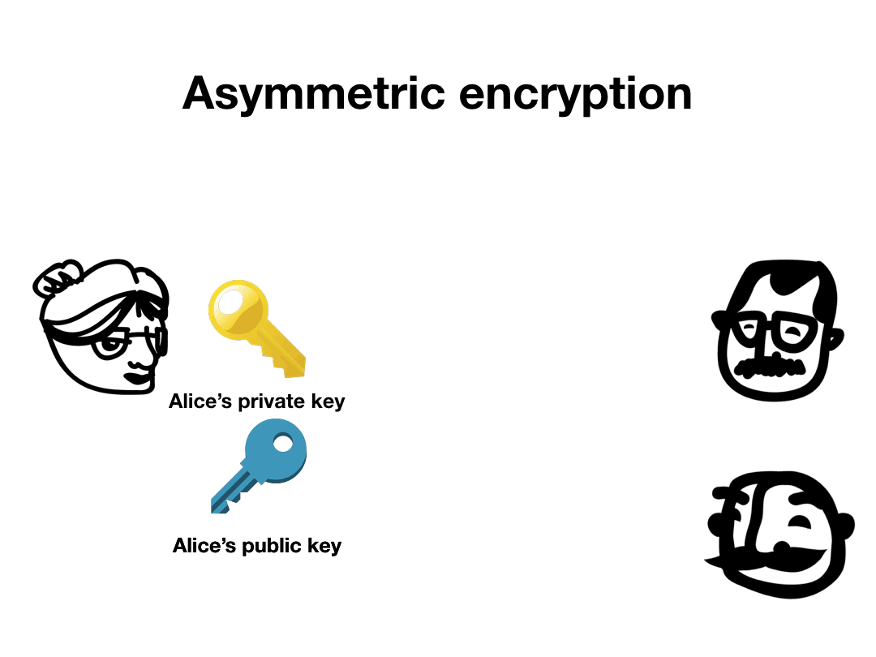
Public Key Scheme

Slide 6
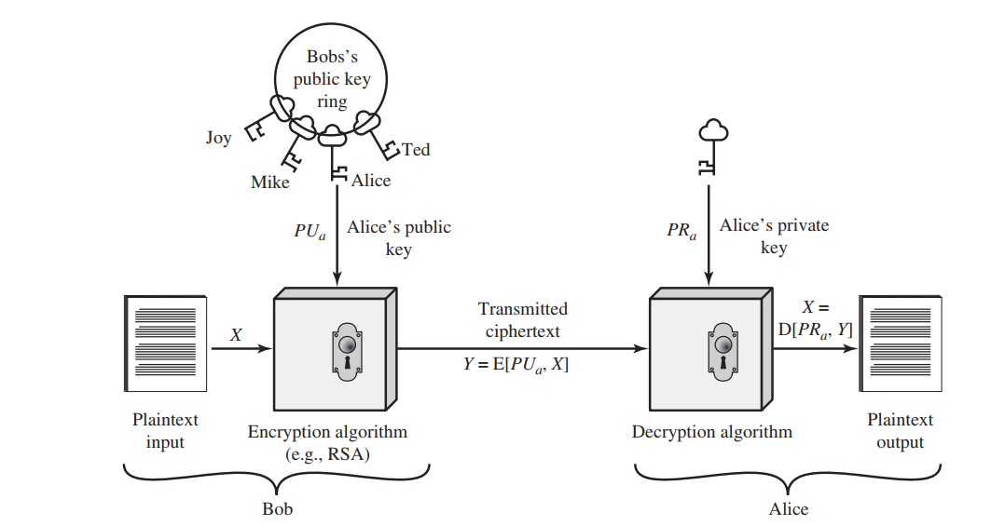
Public Key Process

Slide 7
Requirements for Public-Key Cryptography
It is computationally easy for a party B to generate a pair (public key PU_{b}, private key PR_{b}).
It is computationally easy for a sender A, knowing the public key and the message to be encrypted, M, to generate the corresponding ciphertext: C = E(PU_{b}, M)
It is computationally easy for the receiver B to decrypt the resulting ciphertext using the private key to recover the original message: M = D(PR_{b},C) = D[PRb, E(PU_{b}, M)]
It is computationally infeasible for an opponent, knowing the public key, PU_{b}, to determine the private key, PR_{b}.

Slide 8
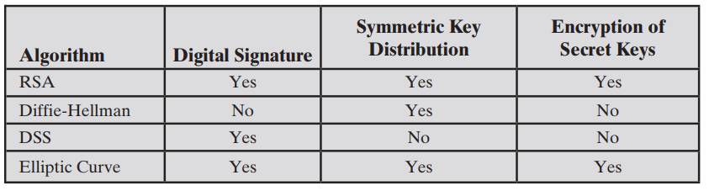
Applications for Public-Key Cryptosystems

Slide 9
Diffie-Hellman (DH)
Diffie Hellman (DH) key exchange algorithm is a method for securely exchanging cryptographic keys over a public communications channel. Keys are not actually exchanged – they are jointly derived.
The purpose of the algorithm is to enable two users to securely reach agreement about a shared secret that can be used as a secret key for subsequent symmetric encryption of messages.

Slide 10
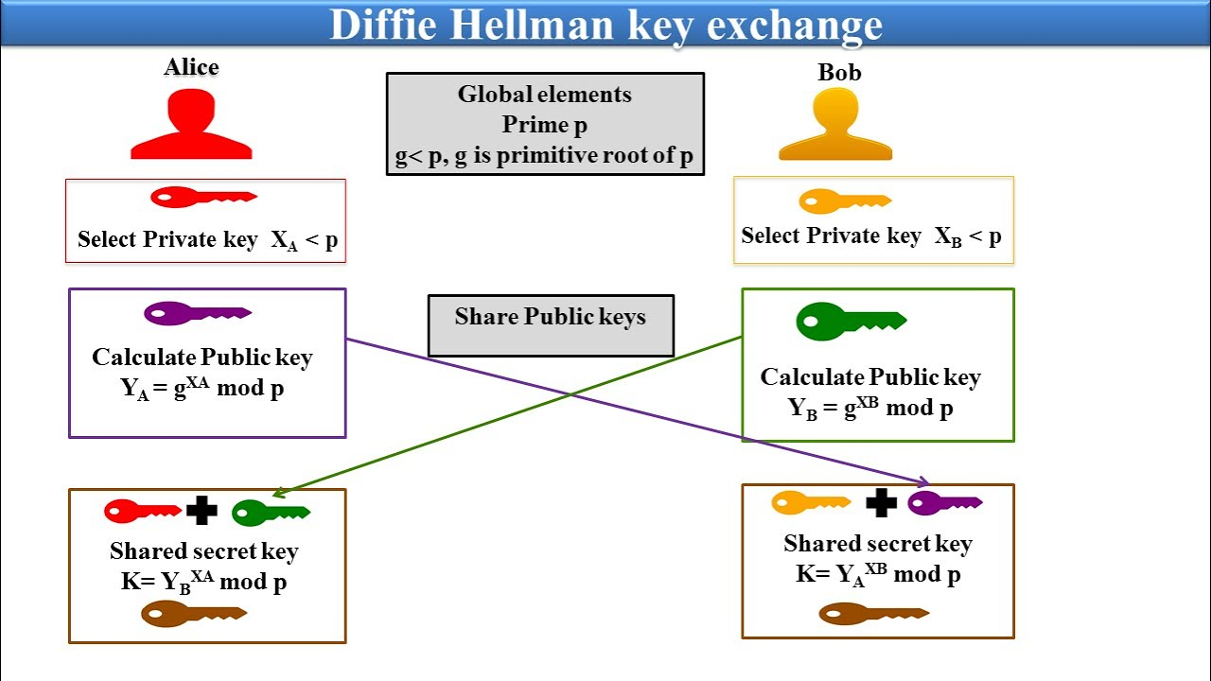

Slide 11
Primitive Root Calculation*
We need a value g such that the order of g [the smallest integer n≥1 such that g^{n}=1mod(p)] is a multiple of a large enough prime q.
There is no security issue with Diffie-Hellman (or DSA) if you reuse previously generated p, q and g.
You can pick up "standard“: RFC 2409 (section 6.2) or RFC 5114 (sections 2.1 to 2.3).
* https://en.wikipedia.org/wiki/Primitive_root_modulo_n

Slide 12
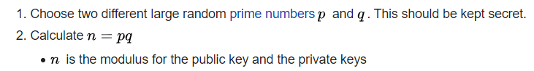
RSA (Rivest–Shamir–Adleman) Key Calculation

Slide 13


RSA (Rivest–Shamir–Adleman) Key Calculation

Slide 14
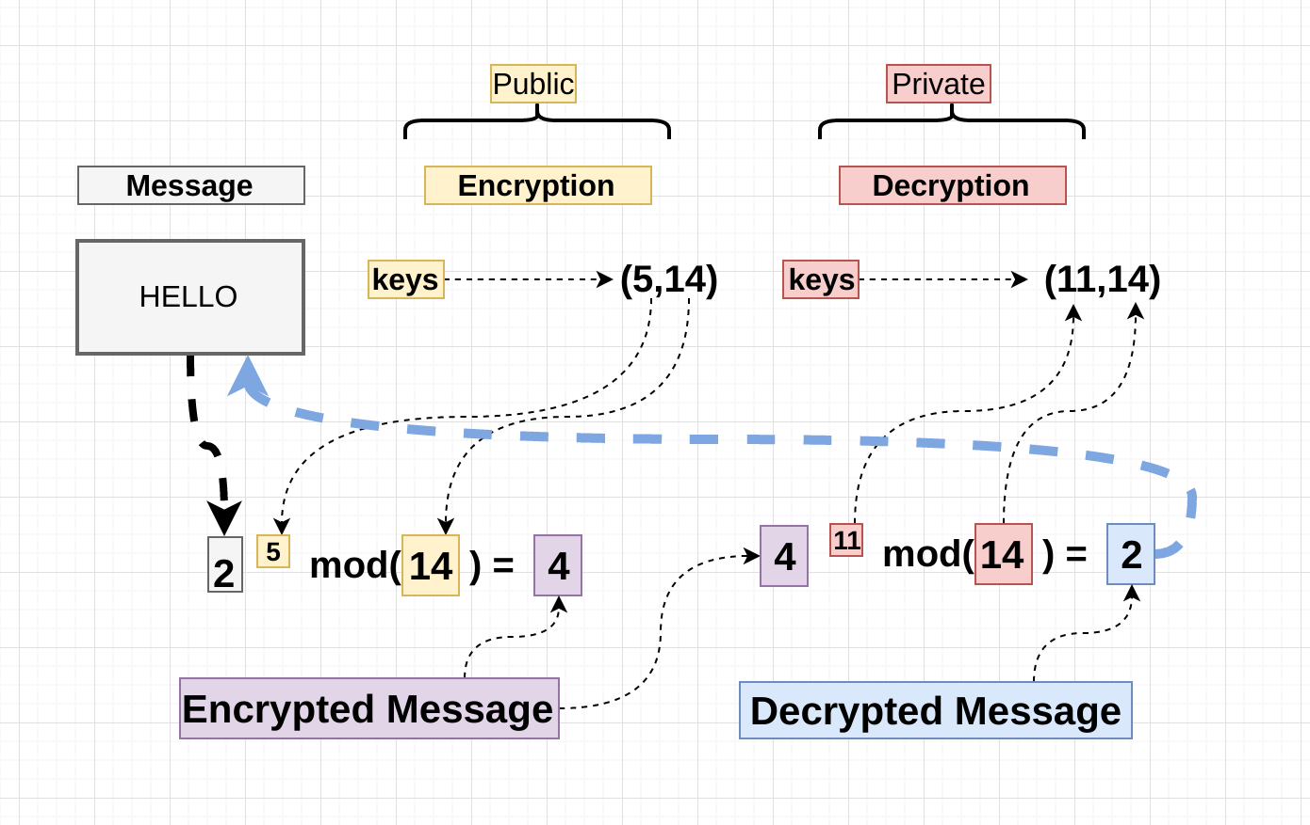
RSA Encrypting & Decrypt message

Slide 15
Digital Signature

Slide 16
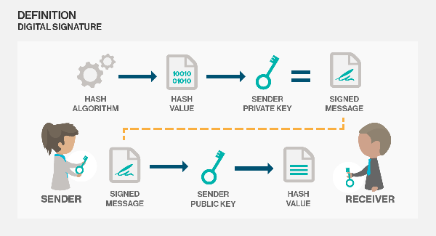
Digital Signature

Slide 17
Public Key Certificate
On the face of it, the point of public-key encryption is that the public key is public.
Thus, if there is some broadly accepted public-key algorithm, such as RSA, any participant can send his or her public key to any other participant or broadcast the key to the community at large.
Although this approach is convenient, it has a major weakness. Anyone can forge such a public announcement.

Slide 18
Public Key Certificate
The solution to this problem is the public-key certificate.
In essence, a certificate consists of a public key plus a user ID of the key owner, with the whole block signed by a trusted third party.
Certificate Authority (CA) that is trusted by the user community, such as a government agency or a financial institution.

Slide 19
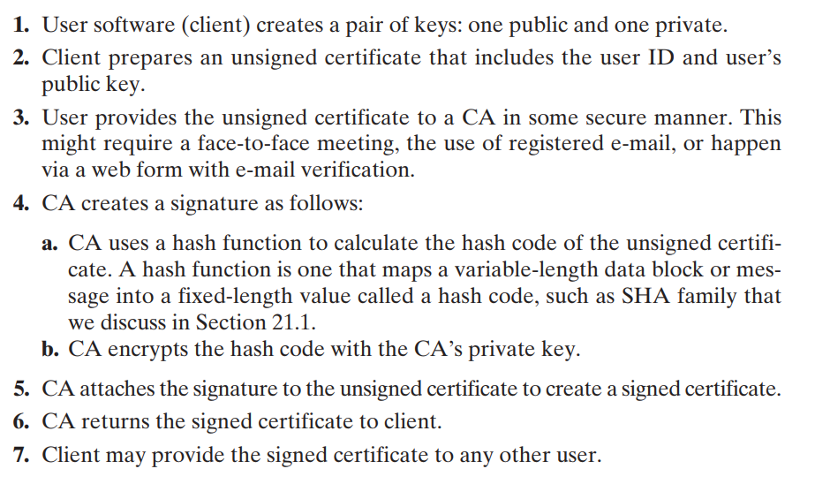

Slide 20
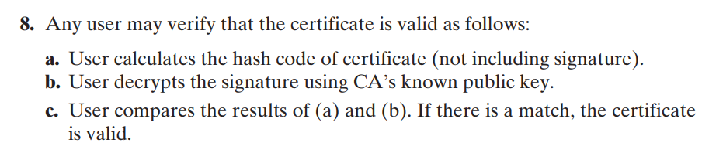

Slide 21
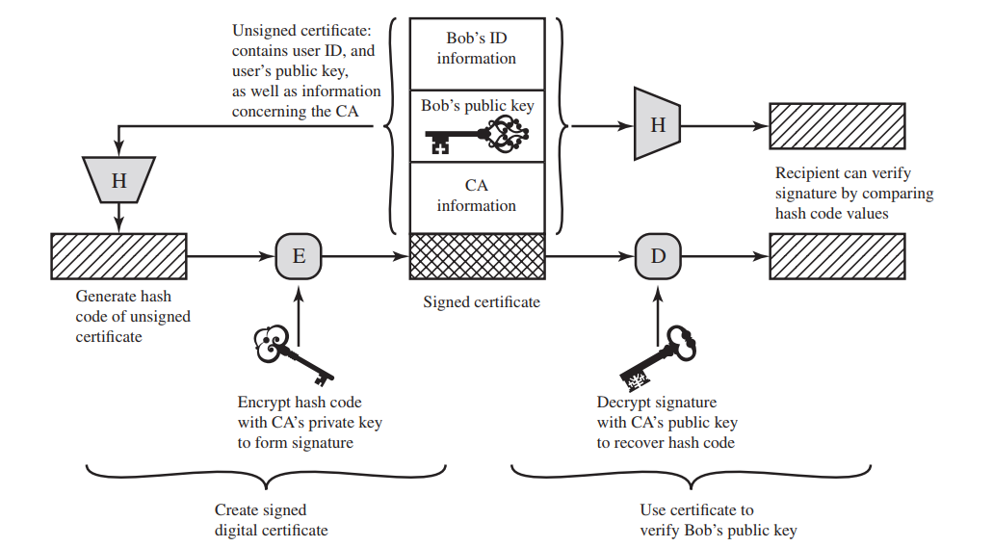

Slide 22
Symmetric Key Exchange Using Public-Key Encryption
Diffie-Hellman
Digital Envelop

Slide 23
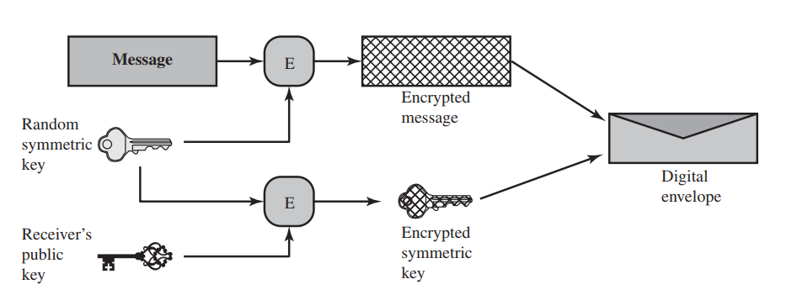
Symmetric Key Exchange Using Public-Key Encryption
Digital Envelopes
Creation of a digital envelope

Slide 24
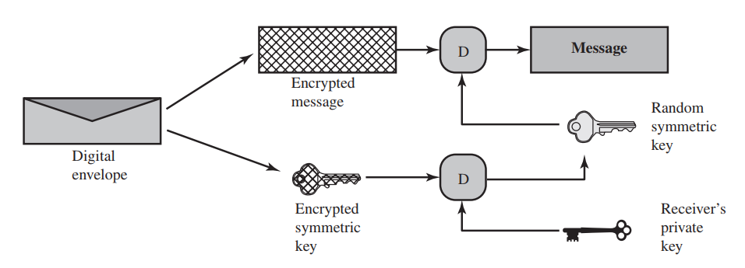
Symmetric Key Exchange Using Public-Key Encryption
Opening a digital envelope
Digital Envelopes

Slide 25
Unit 3 – Cryptography Technology (II)
Asymmetric Encryption
Digital Signature

Slide 26
Computational Intelligence (TC2027)

